Slide 1
Osher Lifelong Learning Institute, Summer 2024
Contemporary Economic Policy
Dartmouth College
Host: Jon Haveman, PhD
National Economic Education Delegation

Slide 2
Available NEED Topics Include:
US Economy
Healthcare Economics
Climate Change
Economic Inequality
Economic Mobility
Trade and Globalization
Minimum Wages
Immigration Economics
Housing Policy
Federal Budgets
Federal Debt
Black-White Wealth Gap
Autonomous Vehicles
US Social Policy

Slide 3
Submitting Questions
Submit questions in the chat or by raising your digital hand.
  I will try to handle them as they come up.
10 minute break towards the middle of the talk.
We will do a verbal Q&A once the material has been presented.
Slides will be available tonight. (https://NEEDEcon.org/delivered_presentations.php).

Slide 4
Course Outline
Contemporary Economic Policy
  Week 1 (6/24): Economic Update (Geoffrey Woglom, Amherst College)
  Week 2 (7/01): International Institutions (Alan Deardorff, U of Michigan)
  Week 3 (7/08): Globalization at A Crossroads (Emily Blanchard, Dartmouth College)
  Week 4 (7/15): Climate Change Economics (Sarah Jacobson, Williams College)
  Week 5 (7/22): Federal Debt and Deficits (Kathryn Wilson, Kent State University)
  Week 6 (7/29): Autonomous Vehicles (Arkadiusz Mironko, Indiana University East)

Slide 5
OLLI – Dartmouth College
Driving Change – Autonomous Vehicles’ Big Impact
National Economic Education Delegation
Arkadiusz Mironko, Ph.D.
July 29, 2024

Slide 6
Credits and Disclaimer
This slide deck was authored by:
  Jon Haveman, NEED
This slide deck was reviewed by:
  Ronald Fisher, Michigan State University
  William F. Fox, University of Tennessee, Knoxville
Disclaimer
  NEED presentations are designed to be nonpartisan.
  It is, however, inevitable that the presenter will be asked for and will provide their own views.
  Such views are those of the presenter and not necessarily those of the National Economic Education Delegation (NEED).
Notes:
Arkadiusz Mironko authored ## of slides

Slide 7
Outline
Where does the AV path lead?
How soon will we get there?
Policy/Planning, Economic/Development Changes
What new business models will emerge?

Slide 8
All vehicles fall into one of six levels of autonomy as defined by SAE
Notes:
the Society of Automotive Engineers

Slide 9
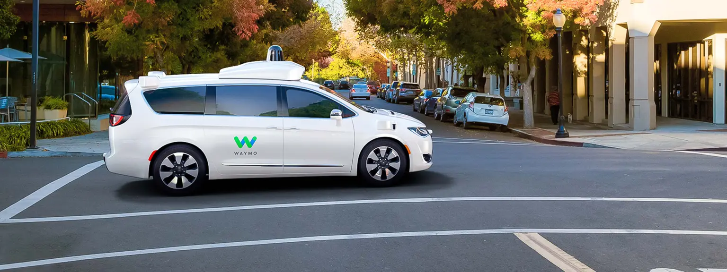
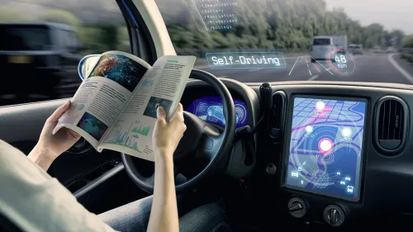
https://www.freethink.com/hard-tech/driverless-car

Slide 10
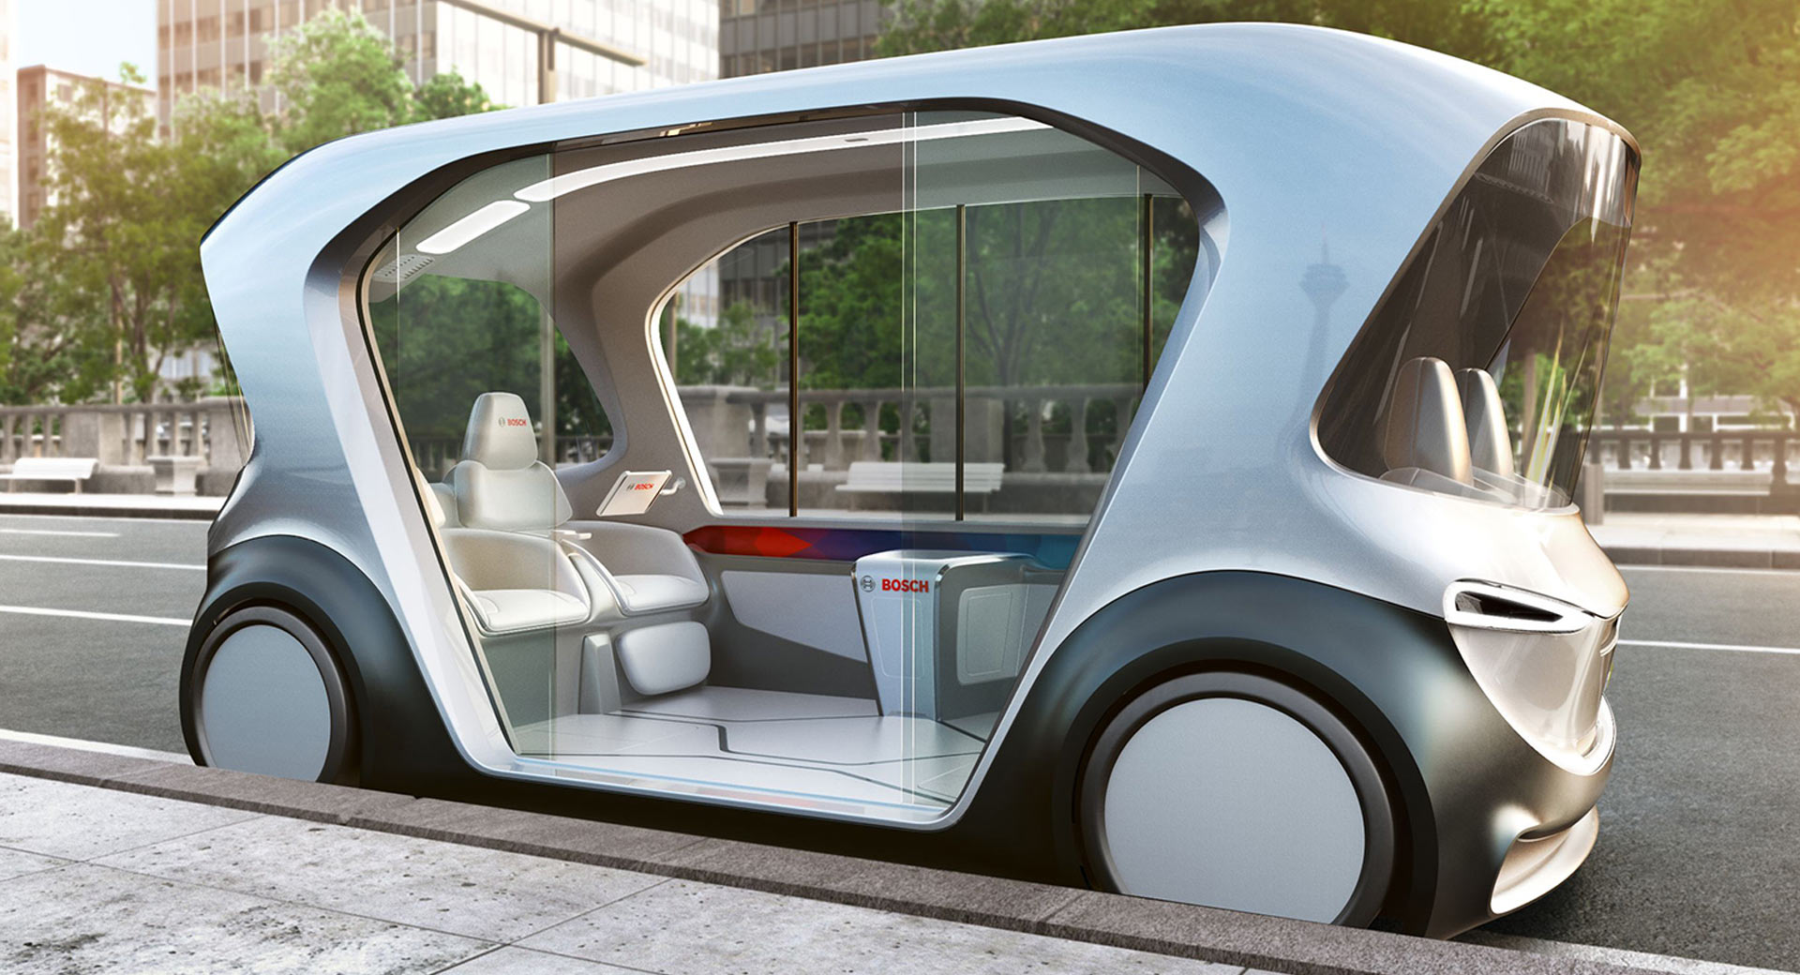
https://www.carscoops.com/2018/12/boschs-autonomous-electric-shuttle-concept-aims-future-travel/

Slide 11



Autonomous Taxonomy

Slide 12
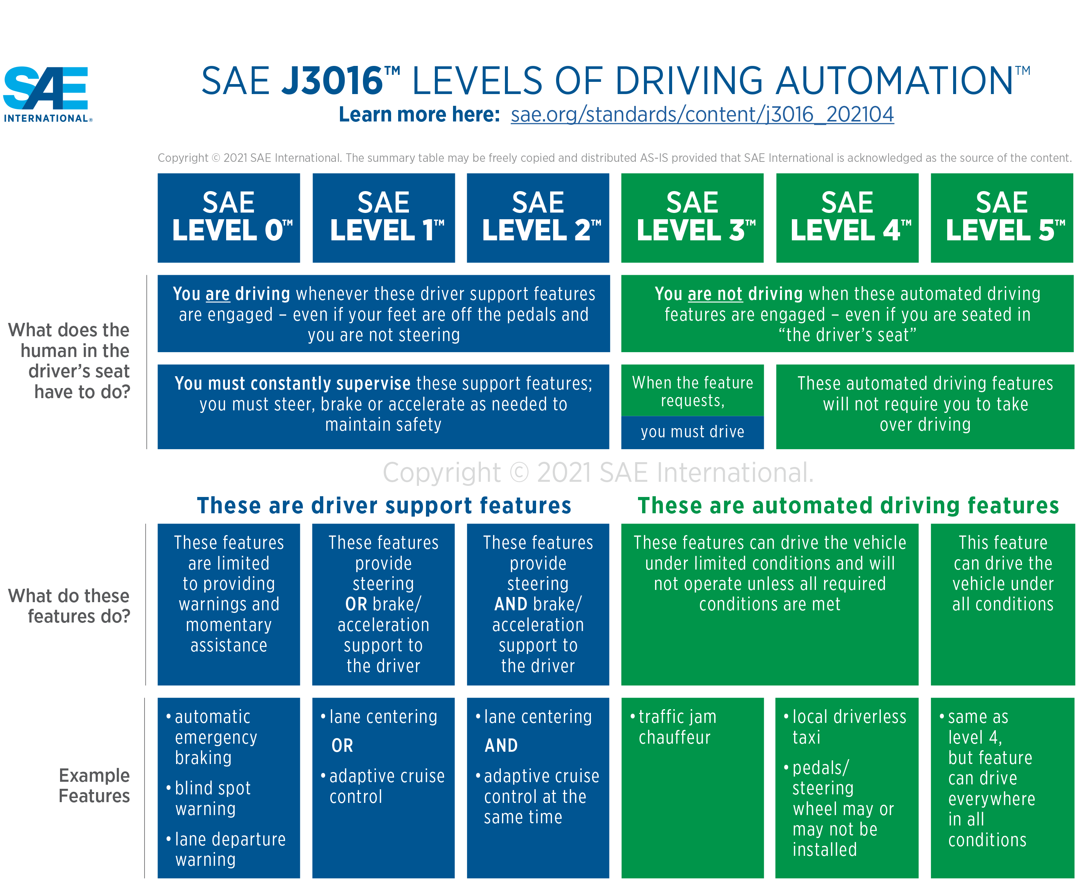
Source: https://www.sae.org/news/press-room/2018/12/sae-international-releases-updated-visual-chart-for-its-%E2%80%9Clevels-of-driving-automation%E2%80%9D-standard-for-self-driving-vehicles
Video:
https://youtu.be/zfkDXQ4pS2k

Slide 13
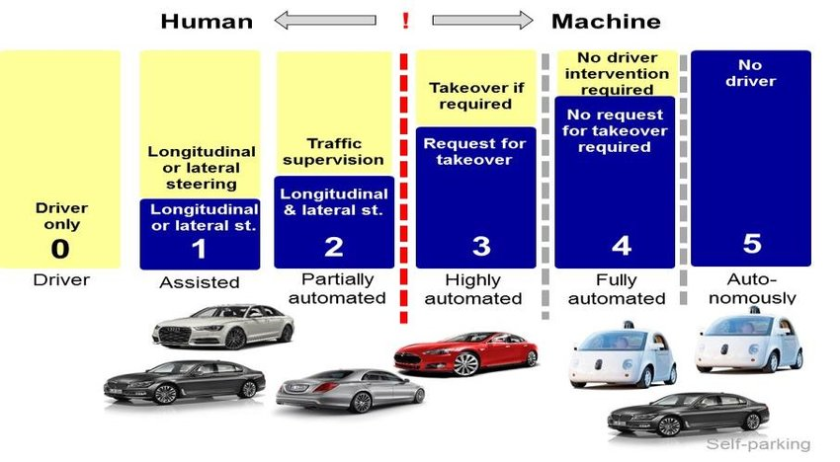
Source: https://www.researchgate.net/figure/Levels-of-autonomous-driving-according-to-SAE-J3016_fig1_322368082

Slide 14
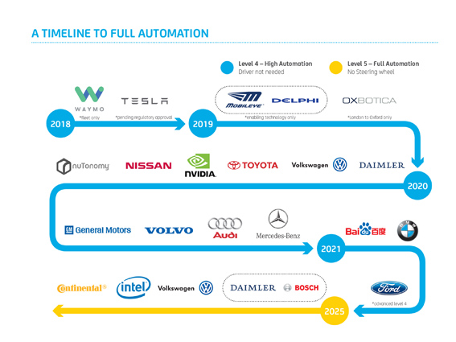
https://www.mynrma.com.au/cars-and-driving/driver-training-and-licences/resources/driverless-cars-the-benefits-and-what-it-means-for-the-future-of-mobility

Slide 15
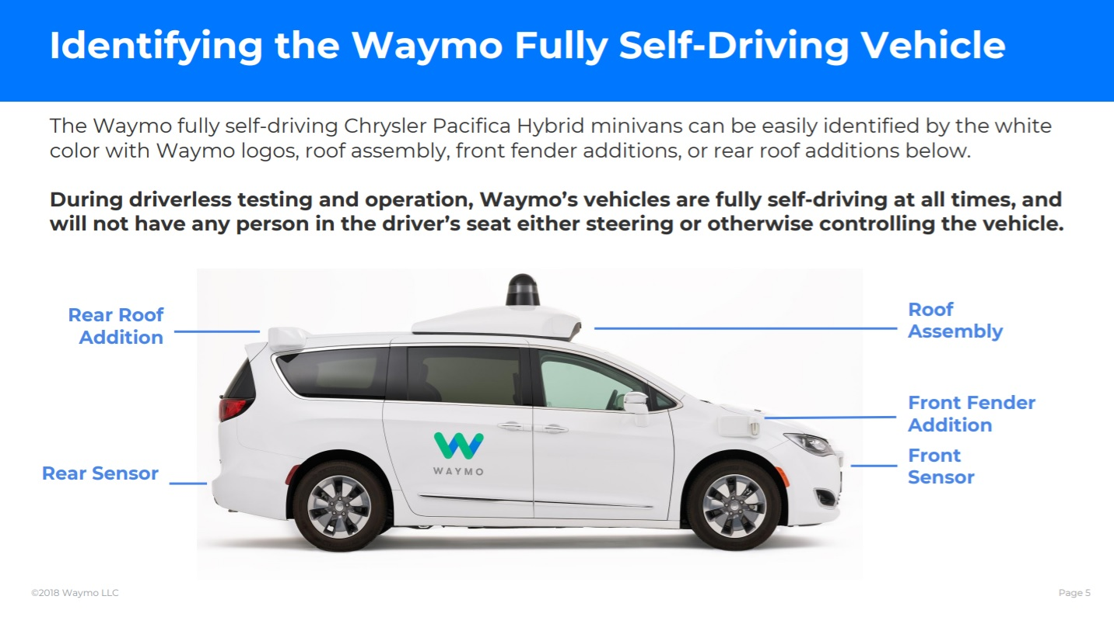
https://www.thedrive.com/tech/24340/waymo-releases-guidelines-for-autonomous-vehicle-tech-crash-response

Slide 16
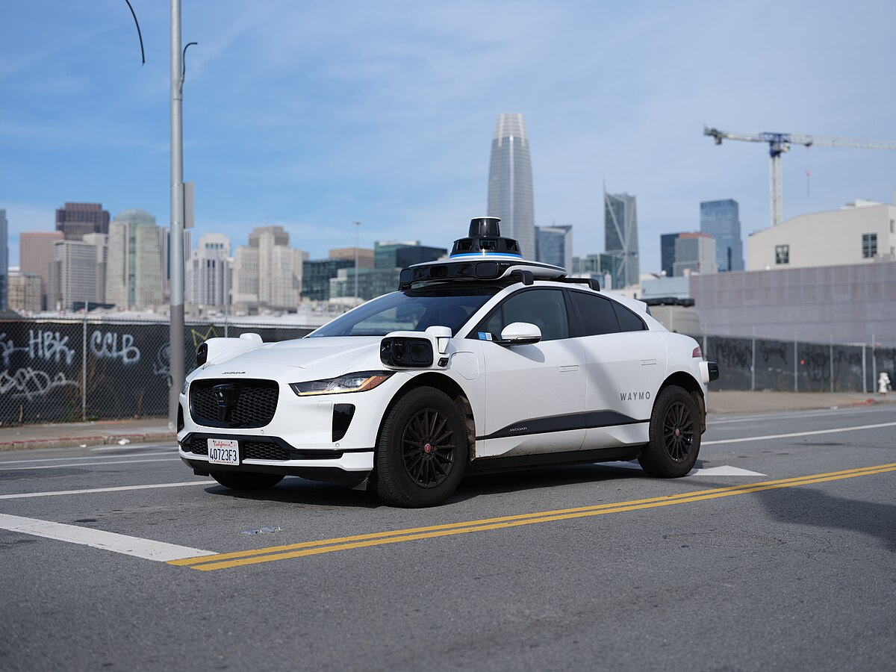

Slide 17
Growth Path
McKinsey & Company
Notes:
This is the growth path according to McKinsey
I believe that the growth path will vary significantly depending on geography
Kansas – very slow
Bay Area – very fast
But I think that they agree with me on where we are headed
Primary means of transport for both people and goods

Slide 18
McKinsey isn’t Always Spot On
"In 1980, McKinsey & Company was commissioned by AT&T to forecast cell phone penetration in the U.S. by 2000.
  The consultant’s prediction, 900,000 subscribers,
  was less than 1% of the actual figure, 109 Million.”
                Professor Angel Lozano, 2014

Slide 19
Three Important Questions:
When will Transportation as a Service (TaaS) be available?
How quick will the transition be?
What will the future look like?
Notes:
4 What business models will apply in use of AVs?

Slide 20





WHEN?
What do the headlines say?
NVIDIA to introduce level-4 enabling system by 2018
First autonomous Toyota to be available in 2020
Volkswagen expects first self driving cars on the market by 2019
Elon Musk now expects first fully autonomous Tesla by 2019, approved by 2021
Audi to introduce a self-driving car by 2020

Slide 21


























40+ Corporations Working On Autonomous Vehicles

Slide 22
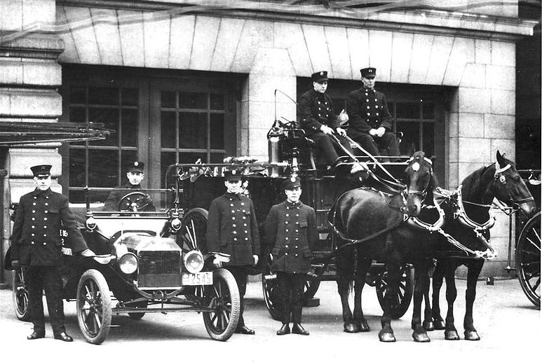

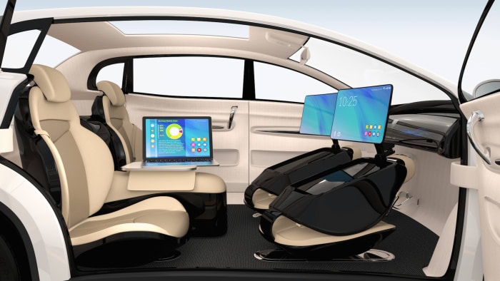
WHEN?
What is possible?
By 2025 (?)
Potentially 95% of VMT by 2035.
  Last 5% may be very difficult to achieve.
Is this possible?
  Horses to cars: 10 years – early 1900s
  But adoption of EVs is so slow!
    Range anxiety and sticker shock.
  Adoption of AVs will be rapid.

Slide 23
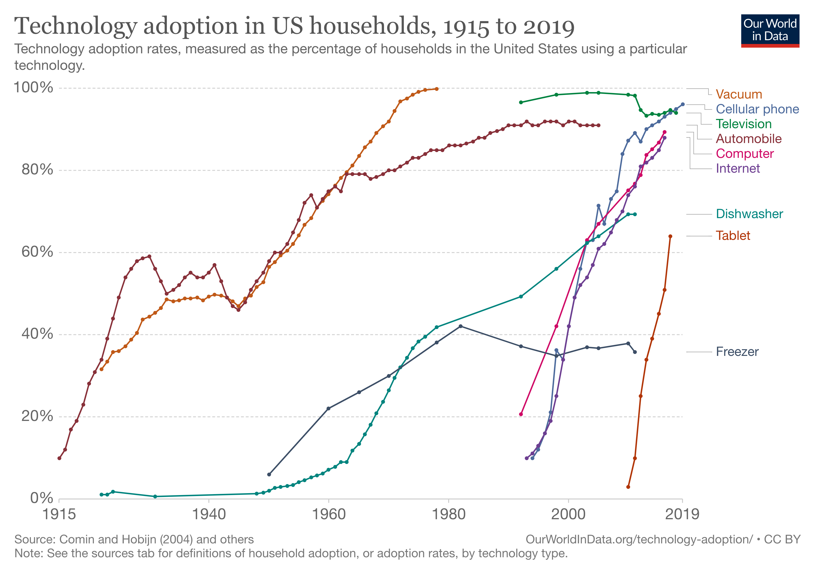
Rate of Technology Adoption – Faster!

Slide 24
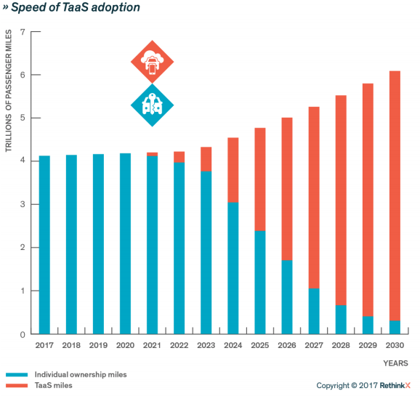
Forecast
Timing may be off.
But the point is:
RAPID ADOPTION!
The Big Unknown
I say: 2030!

Slide 25





Slide 26
Fee-For-Service Autonomous TaaS
Waymo: Charging for rides in SF , LA, and Phoenix
Motional: Las Vegas
Arlington, TX: Minibuses – Milo and Drive.ai
More are surely coming soon….

Slide 27
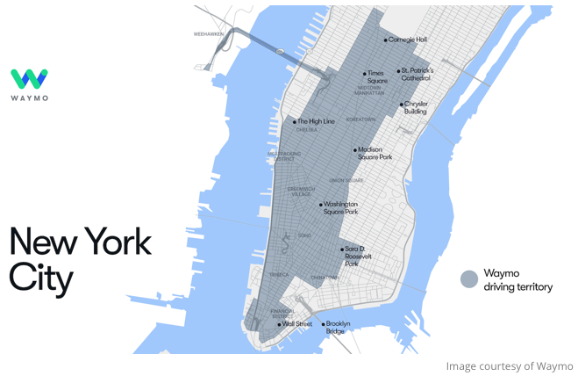
Waymo is (was?) Exploring New York City!

Slide 28
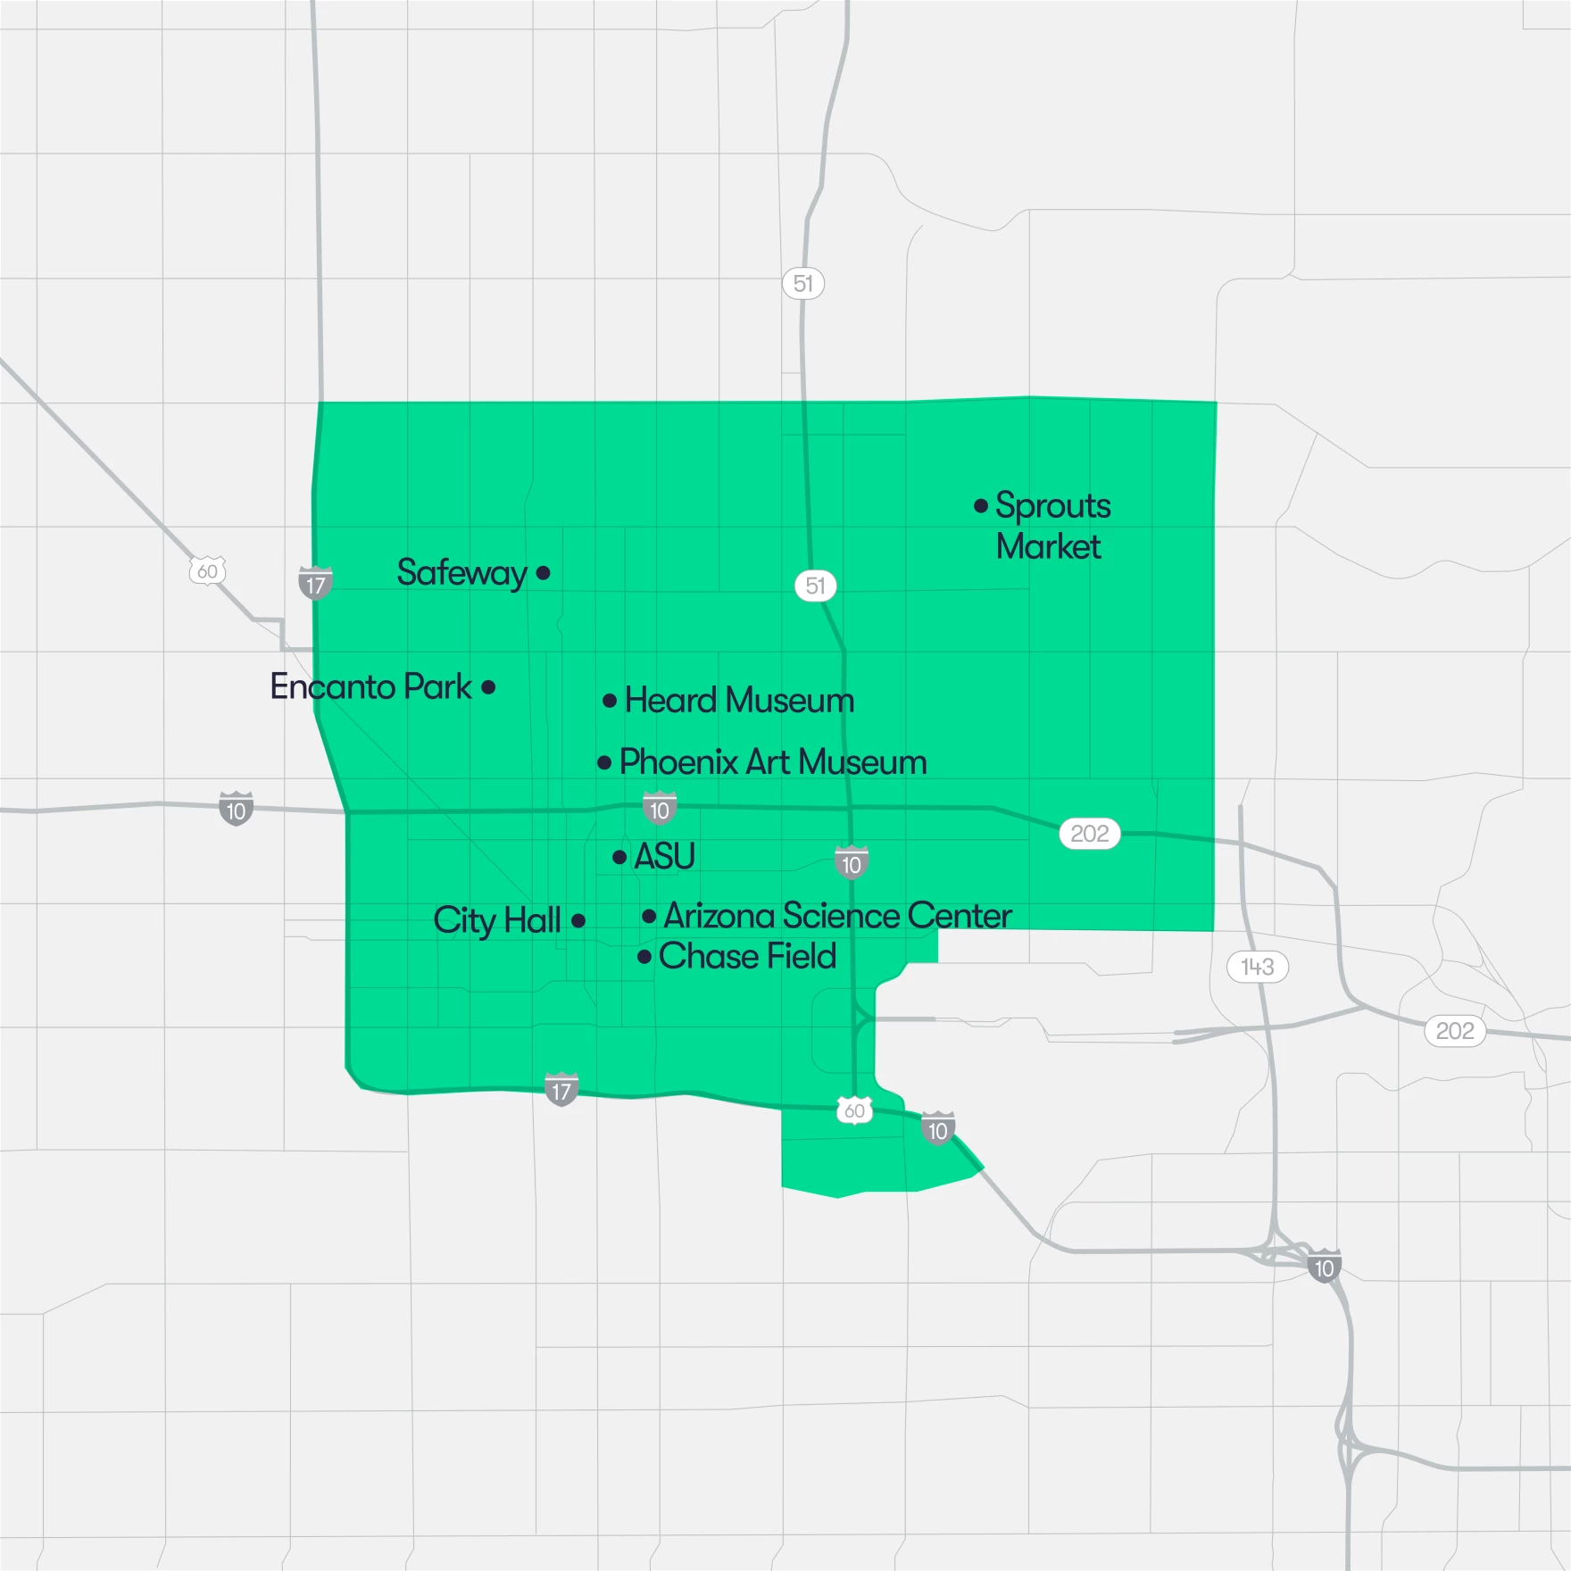
Waymo is Exploring Phoenix, AZ
Map of the Waymo Trusted tester area in downtown Phoenix.
Source: https://www.kjzz.org/2022-04-15/content-1772560-waymo-expands-driverless-car-service-downtown-phoenix

Slide 29
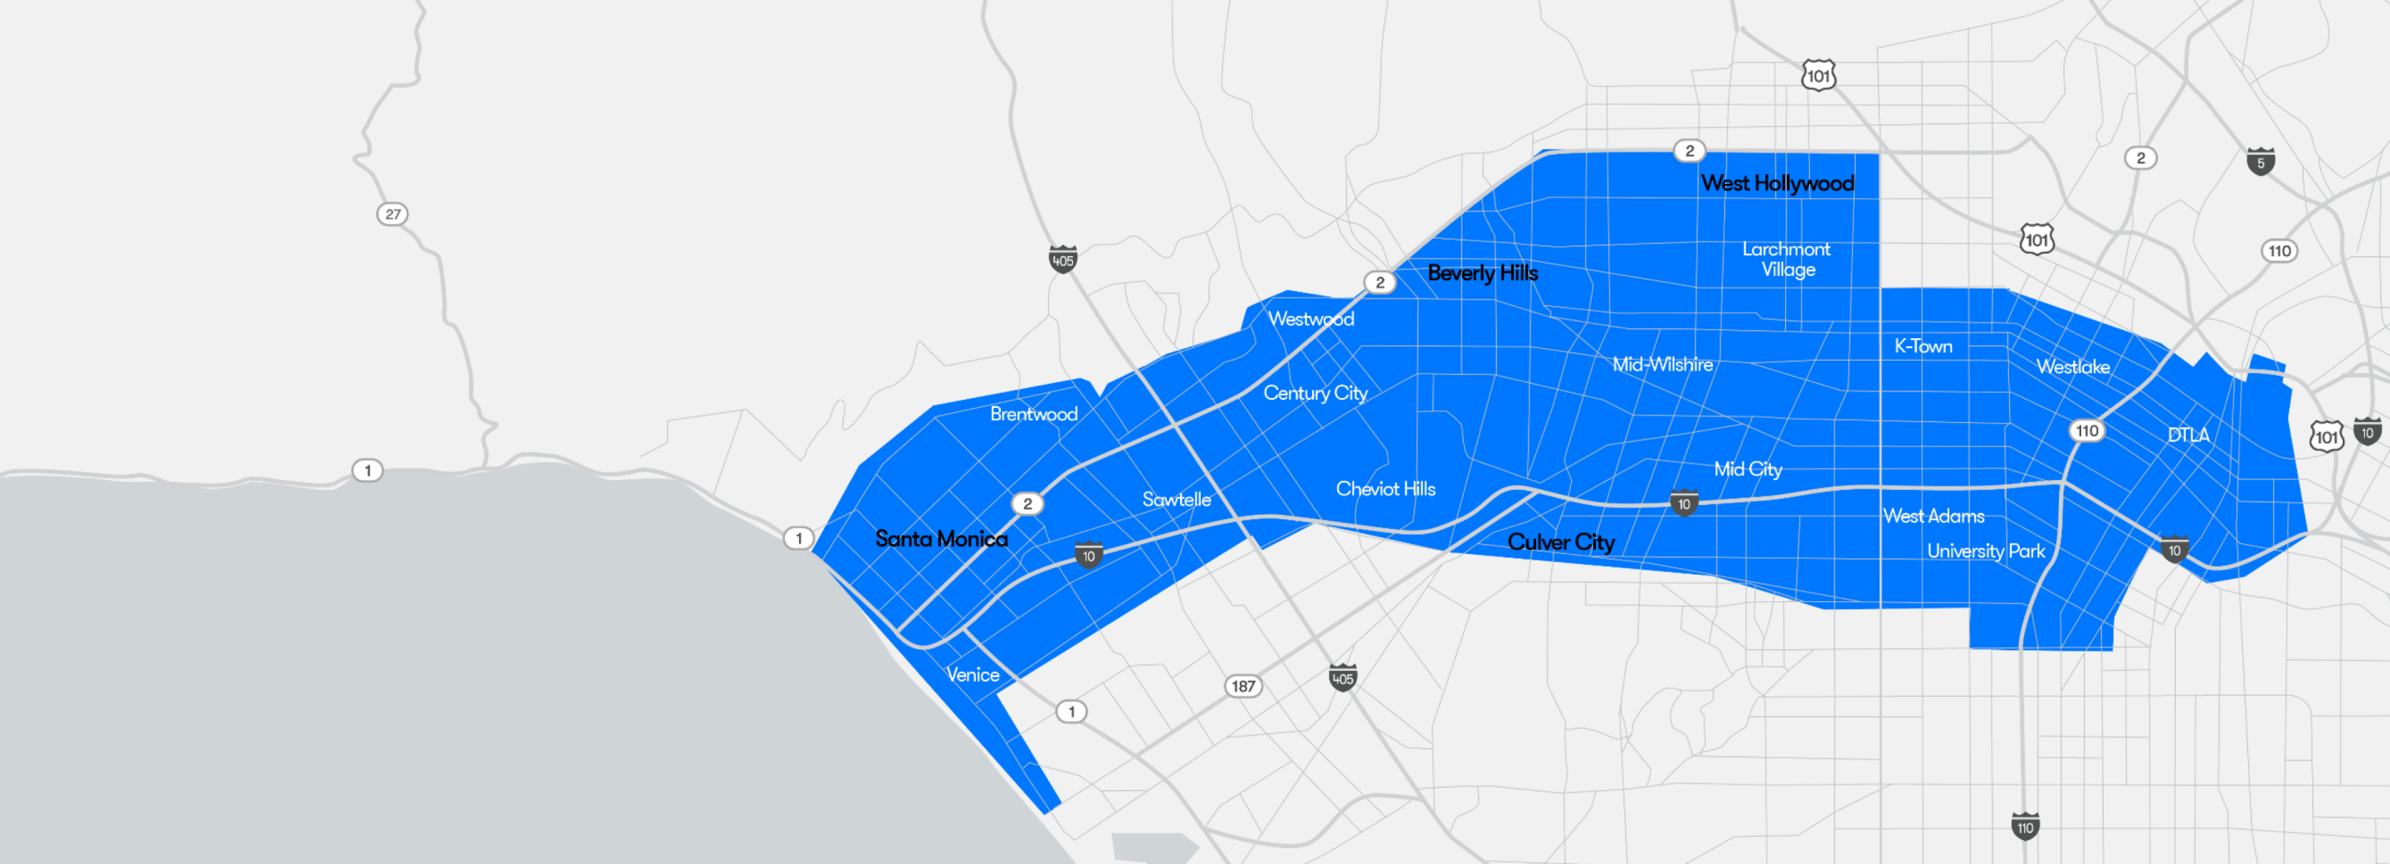
Waymo is Exploring Los Angeles
Source: https://waymo.com/waymo-one-los-angeles/

Slide 30
Trucking – Highly Fertile Ground
Long haul trucking is likely the first place we will see it adopted.
  Reduces costs associated with drivers.
  End run around limits on hours of driving.
Where does it stand?
  Lots of trials underway.
  TuSimple – actively building a long haul network.
  Waymo – focused more on last mile/local delivery.

Slide 31
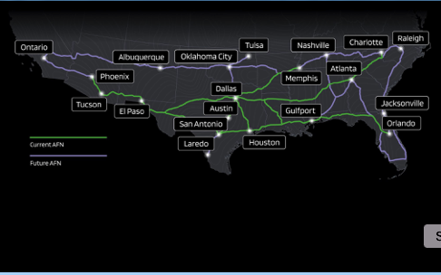
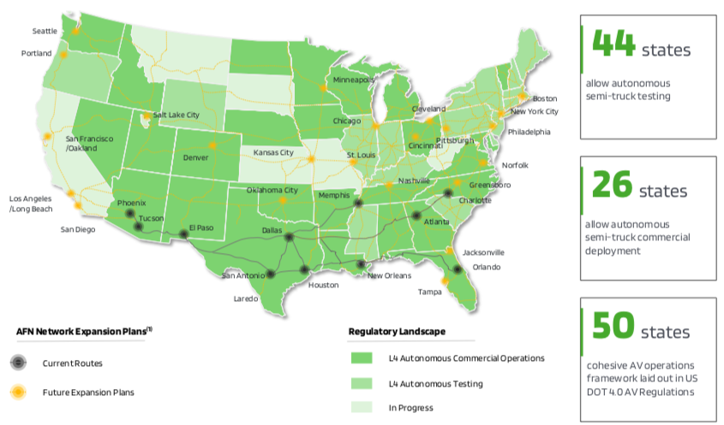
TuSimple Current and Future Routes (Level 4)
the Autonomous Freight Network (AFN)
Notes:
the Autonomous Freight Network (AFN),
https://www.linkedin.com/pulse/tusimple-achieves-level-4-semi-driving-david-nishimoto-3e3fc/
https://ops.fhwa.dot.gov/freight/freight_analysis/nat_freight_stats/nhsmajortrkrts2040.htm
https://www.google.com/search?q=afn+level+4+truck+routes&rlz=1C1GCEA_enUS1115US1115&oq=afn+level+4+truck+routes&gs_lcrp=EgZjaHJvbWUyBggAEEUYOTIHCAEQIRigATIHCAIQIRigATIHCAMQIRigATIHCAQQIRigAdIBCTExOTIxajBqOagCALACAQ&sourceid=chrome&ie=UTF-8#vhid=oCkeuUNhLDbQxM&vssid=l

Slide 32
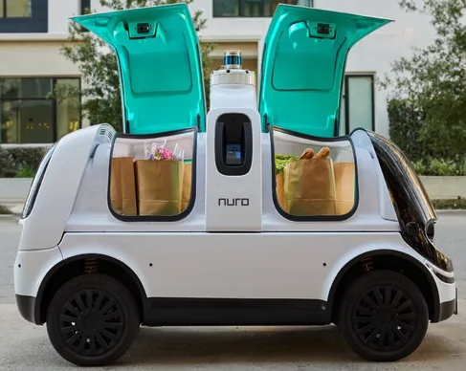
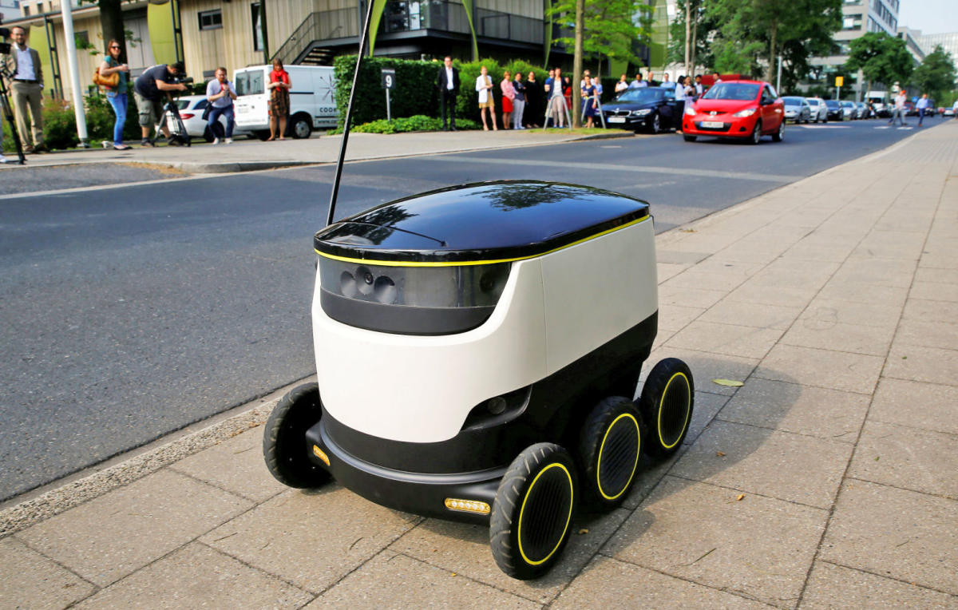
Actively Pursuing Autonomous Local Delivery
Dominos
Walmart
Amazon
CVS Pharmacy
Stop and Shop
Postmates
Kroger
Notes:
https://www.makeuseof.com/companies-testing-self-driving-cars/
https://www.yahoo.com/news/2017-01-18-doordash-and-postmates-test-deliveries-by-robot.html

Slide 33
What will the future look like?

Slide 34
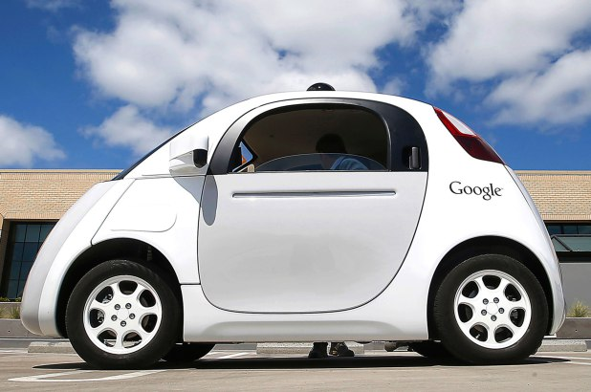
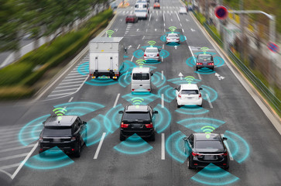
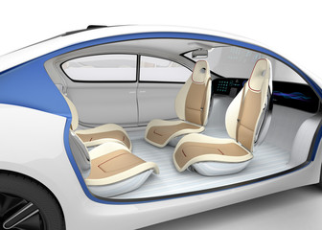

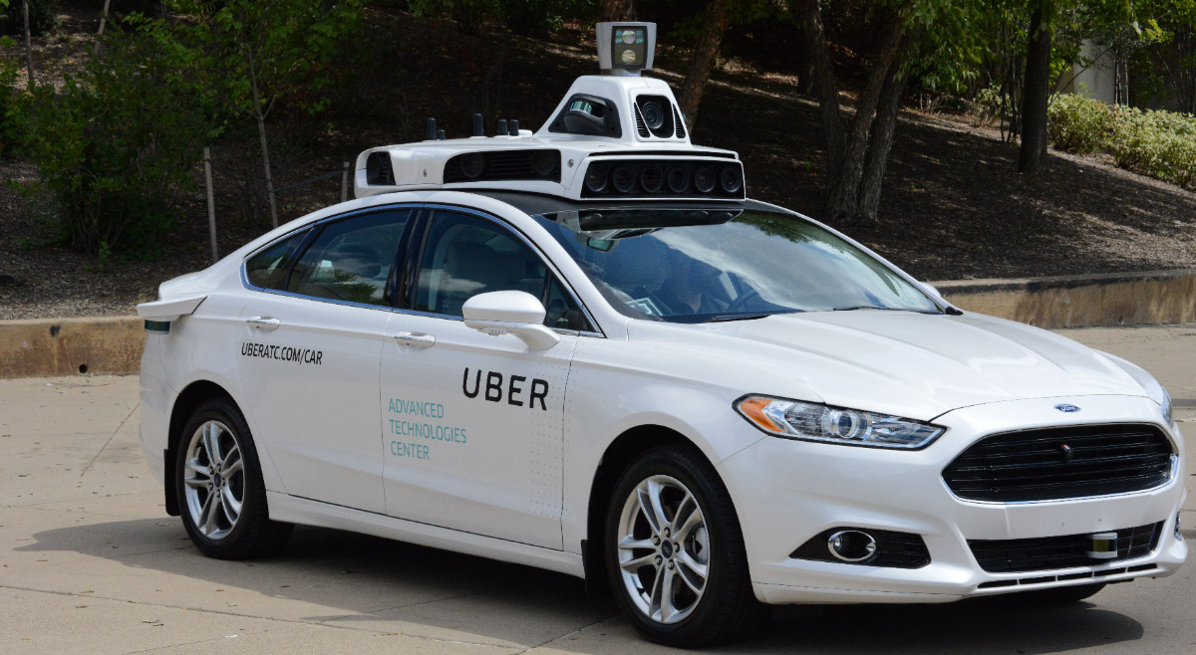
This:

Slide 35



But, will it be:
Heaven?
OR
Hell?

Slide 36

Hell
Primarily individual private car ownership
  Much as today.
Internal combustion engines
Why Hell?
  Dramatically increased VMT and pollution.
  Potentially increased congestion.
  Parking

Slide 37
Two Adults and a Child: Morning Miles
Parking
Office 1
1
2
3
4
School
Home
5
7
6
Office 2
And this is just the morning…..

Slide 38

Heaven
Vehicle ownership will be very limited
  Private ownership for those with specialized vehicle needs.
  Fleet ownership will serve everybody else.
Engines: electric
Insurance: product liability
Not clear when we will get there, but this is the likely model.
  2030 for widespread adoption in many regions.

Slide 39
Why is this Heaven?
Not only autonomous, but:
  Shared
  Connected
  Green
Far fewer cars in existence.
  Better resource utilization: steel, rubber, aluminum, and land!
VMT could go up or down, but more productive than in Hell.
Congestion effects – unclear, but likely reduced.
  Right-sized vehicles, platooning, sharing, V2V communication
Minimal need for parking.

Slide 40
Transition
Short term: Tesla model of highway autonomy
  Level 2, adaptive cruise control
Medium term:
  short period of personal vehicle ownership with level 3 capability
  introduction of independent private fleets – Uber, Lyft, Google, nuTonomy, etc., with level 4/5 capability
Long term:
  Personal vehicle ownership is largely a thing of the past

Slide 41
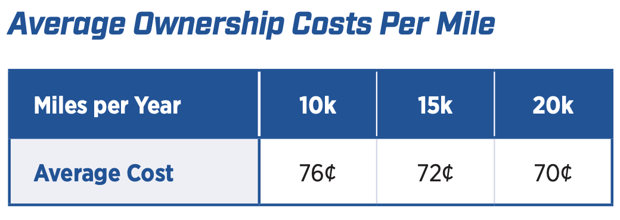
Economics Drives Transition: Private
Adoption dividend for private individuals
  Eliminate car ownership
    Ave annual cost of owning a car: $12,182 (2023)
    Cost per mile will fall: $0.72 to $0.19
  Repurpose your garage
    $50,000 from transition to bedroom
Time recovery (pre-pandemic)
  50% of the SF Bay Area workforce has a commute in excess of 30 minutes.
Notes:
https://www.investopedia.com/articles/pf/08/cost-car-ownership.asp
.19 – source is TaaS report
$50,000 is my own research

Slide 42
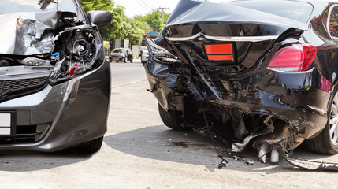

Economics Drives Transition: Public
Economic and social costs associated with human drivers are enormous:
  ACCIDENTS:
    Drive 25% of congestion.
    Result in 40,000 deaths.
    And 2 million injuries.
    90+% caused by human error.
  Increased productivity from not driving.
  Costs of human drivers estimated at up to $1.3 TRillion each year

Slide 43
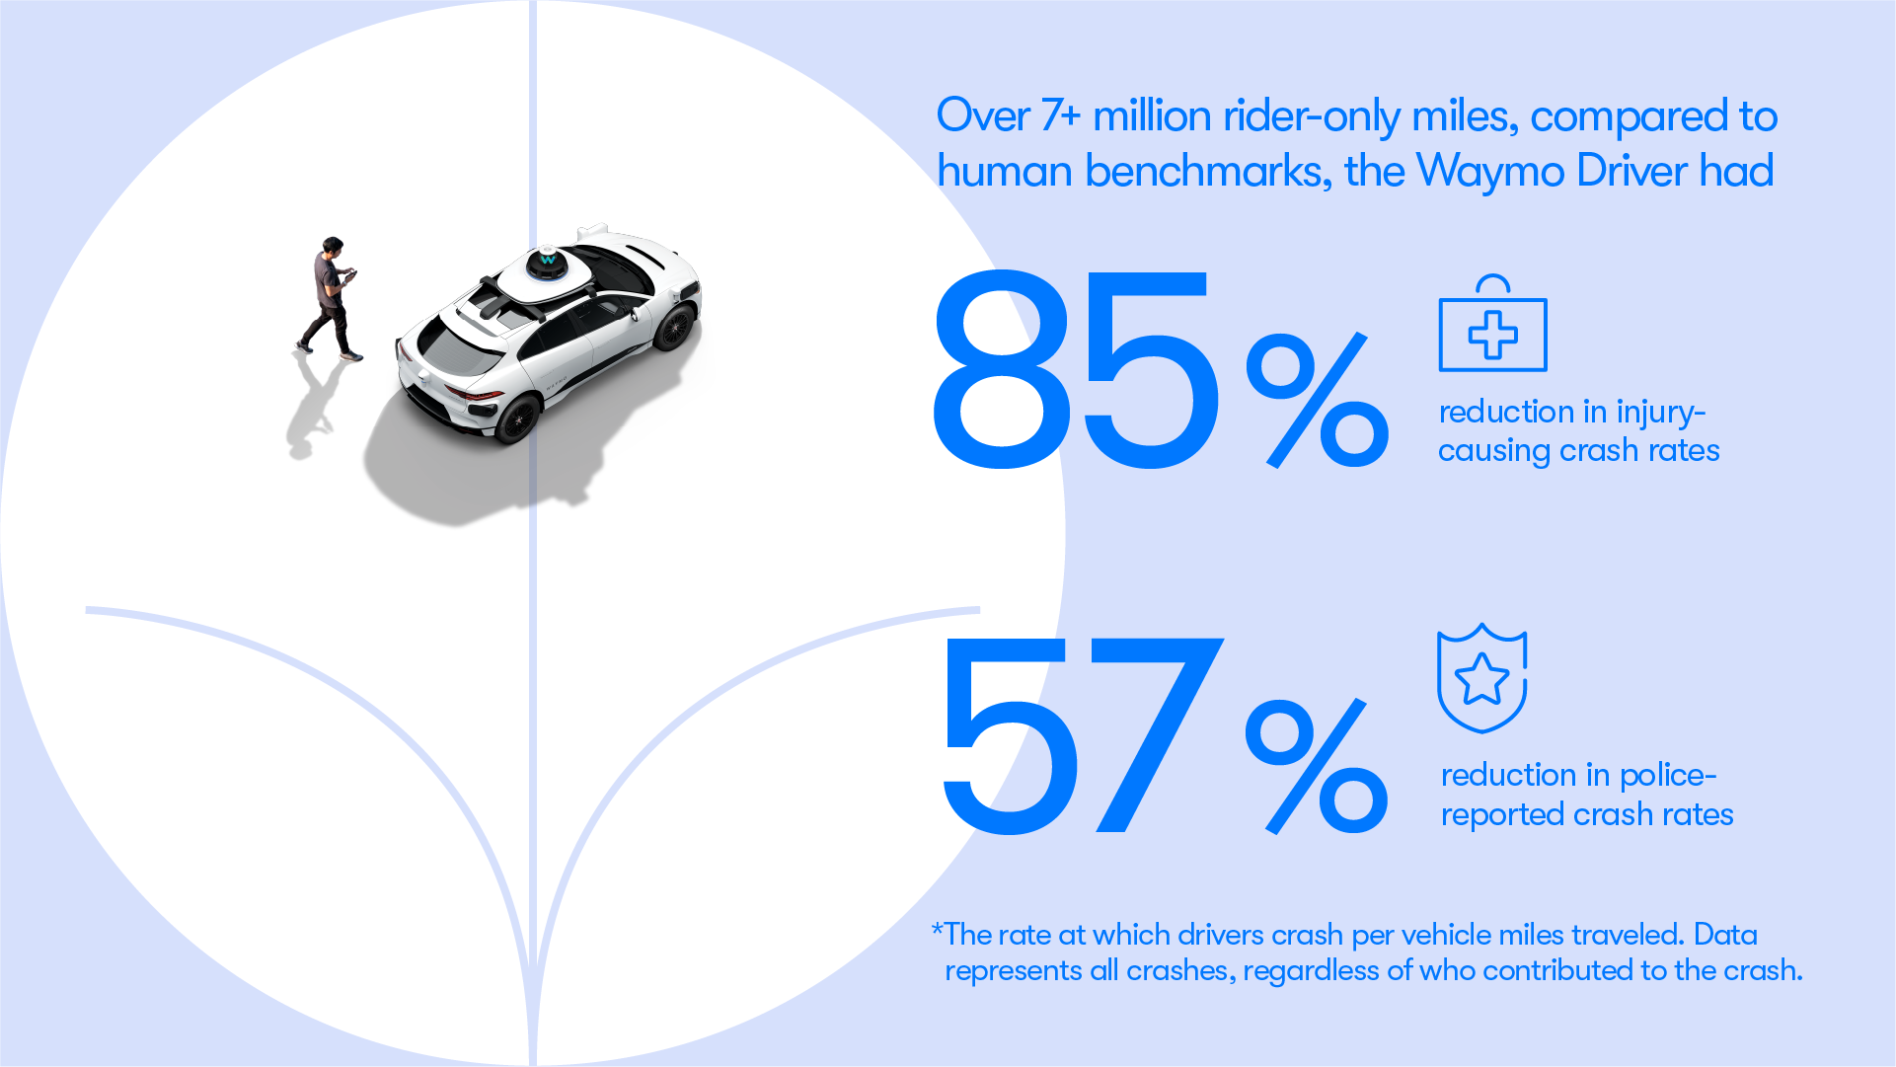
Human drivers vs AVs
“Waymo significantly outperforms comparable human benchmarks over 7+ million miles of rider-only driving”
Source: https://waymo.com/blog/2023/12/waymo-significantly-outperforms-comparable-human-benchmarks-over-7-million/

Slide 44
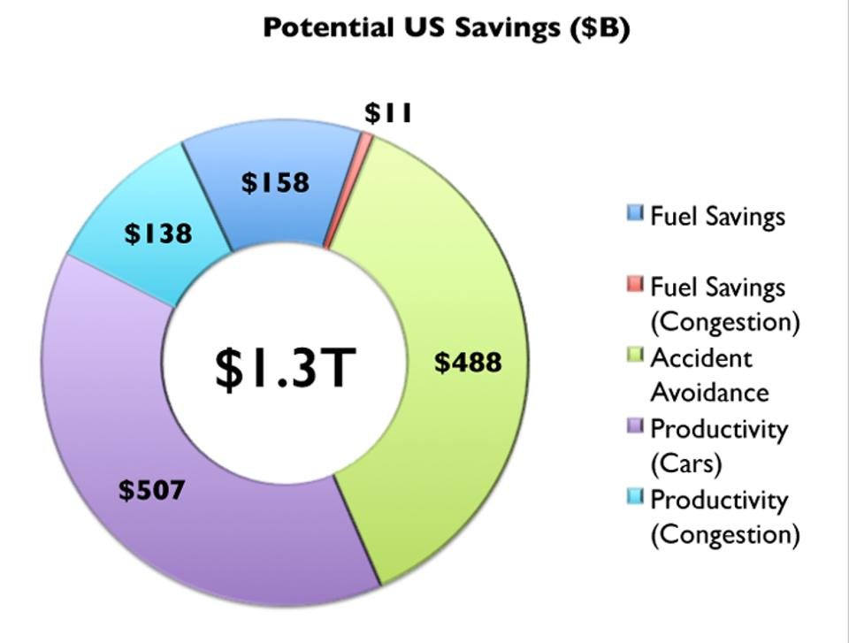
Potential Savings
Morgan Stanley

Slide 45
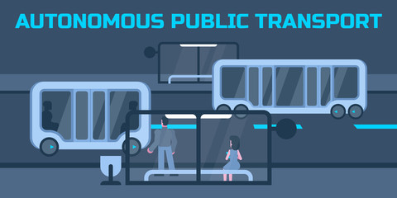
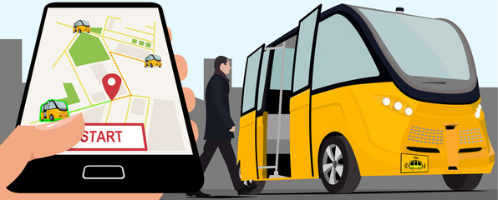
Public Policy/Planning Issues
Government buy-in:
  Essential – gov’t must encourage progress
  Difficult – because of displacement issue
Important transitional issues:
  What infrastructure should be developed?
  What to do about public transportation?
  What to do with all of the parking spaces?

Slide 46
Planning
Respond to the coming changes
  The planning horizon for any investment in transportation infrastructure based on today’s predominant technology has changed.
    It may have gotten MUCH shorter.
Encourage the changes to happen more quickly
  Mobility, safety, productivity, and environmental benefits abound.

Slide 47
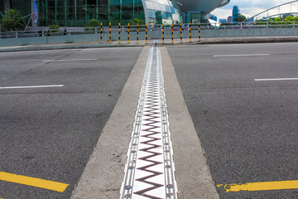
Responding to the coming changes:
Transportation organizations must develop a forecast for adoption in
their specific geography
  San Francisco – faster than Chicago
  Chicago – faster than Fresno
  Fresno - faster than Kansas
How does this affect the ROR
calculation on projects?
  Highway expansion? Public Transportation?

Slide 48
Encourage Change
Mobility and equity considerations
  Elderly/disabled/impoverished
Safety: only way to reduce traffic fatalities is by coordinated effort
Productivity: reduced congestion
Environment: speed transition to electric vehicles
These are all societal benefits that come about too slowly
if the private market is left to itself.
Notes:
Think about star trek and Scotty, beam me up! That's the ideal. We think it and we're in another place. Autonomous vehicles don't achieve that, but they free up the time that is still necessary to get from here to there.- they free up the time that is spent on maintenance - huge economies of scale

Slide 49
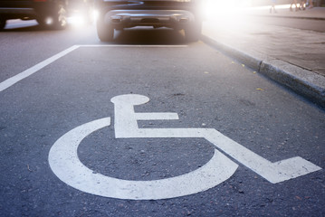



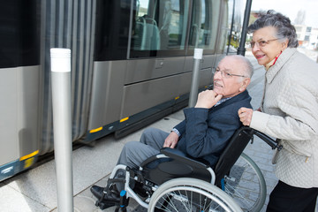
Mobility and Equity
Mobility
  Handicapped
  Elderly
  Lower income
Equity
  Public Transportation often does not work well for low-income workers/residential workers
    Does not go from residential to residential, but from residential to commercial

Slide 50
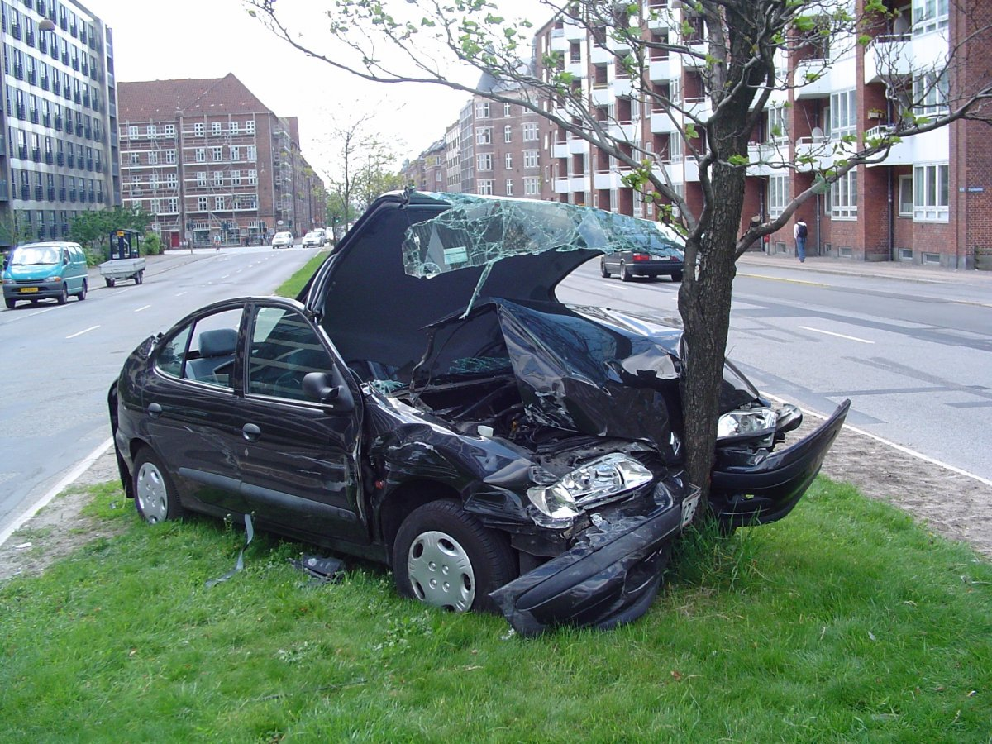
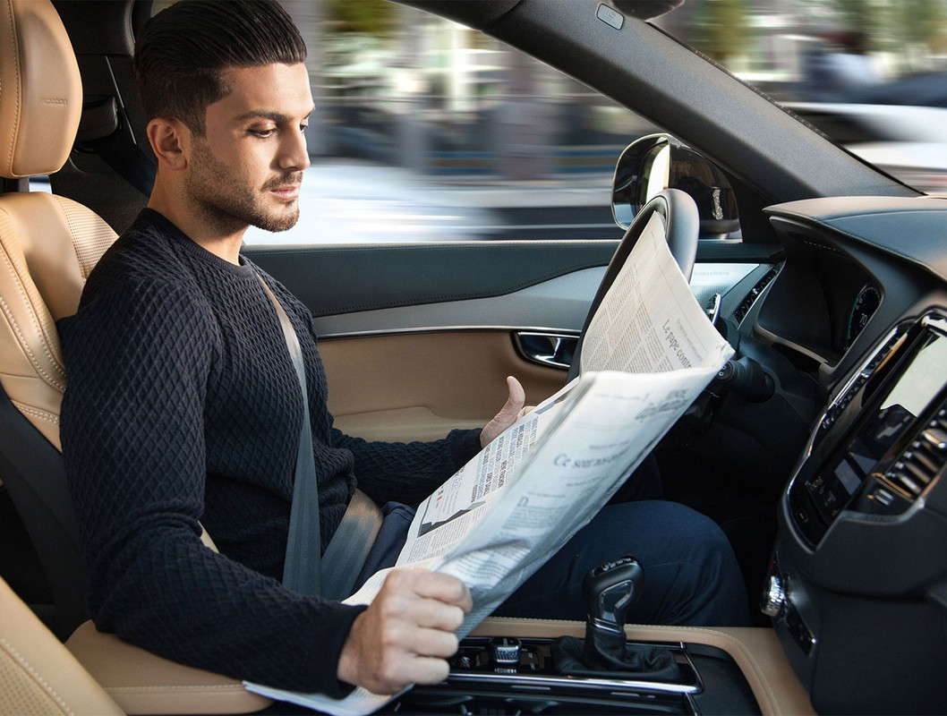
Safety and Productivity

Slide 51
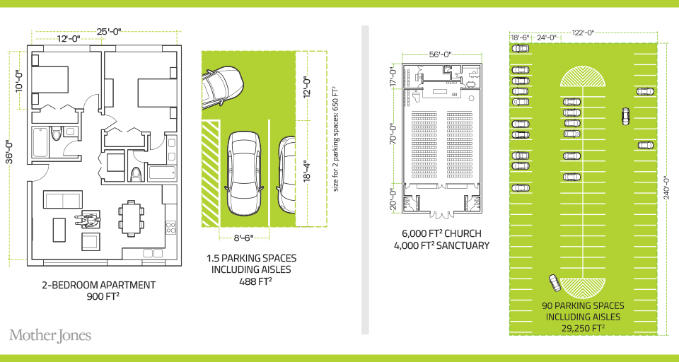
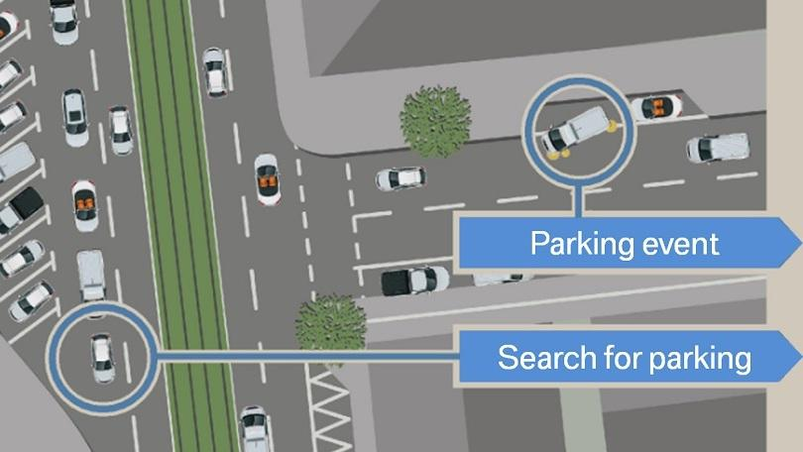
Environment
Notes:
30% of city traffic is due to search for parking

Slide 52
Environmental Implications
Depends: Heaven or Hell
Improved resource utilization
More efficient travel
  Right sized vehicles
  Optimized routes
  Reduced congestion
  No searching for parking
Increased VMT
Cleaner technologies
  Electric
  Lighter vehicles
Energy use of onboard electronics
  Weight and functional
Increased urban sprawl
Bottom line: push governments at all levels to embrace and to implement
policies deterring private vehicle ownership and zero passenger miles
Notes:
Governments determine local zoning, design roadway alignments, invest in new capacity, design parking regulations, set transportation taxes, and invest in data and people to help manage all those decisions. It’s a huge suite of responsibilities, and all apply in new ways around AVs.

Slide 53
Incentives Through Policy and Planning
Allow vehicles equipped with ACC into HOV lanes
  Eventual conversion of HOV lanes to ACC/AV lanes
Allow ACC/AV equipped vehicles to travel faster in HOV lanes
Subsidize ACC/AV upgrades
  Arguably more concrete benefits than electric vehicles
Sticks: higher costs of vehicle ownership
  Registration fees, VMT taxes, etc.
Note: ACC = Adaptive Cruise Control

Slide 54
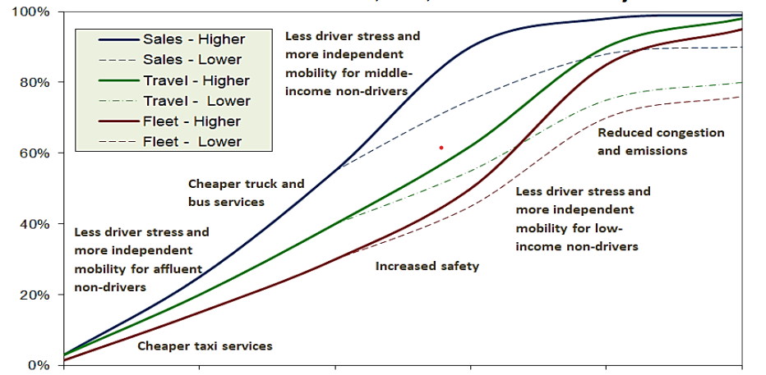
Autonomous Vehicle Sales, Fleet, Travel and Benefit Projections
https://www.bilbloggen.dk/wp-content/uploads/2023/04/Autonomous-Vehicle-Implementation-Predictions.pdf
Notes:
This analysis suggests that it will be at least 2045 before half of new vehicles are autonomous, and 2060 before half of the vehicle fleet is autonomous. Significantly faster deployment will require scrapping many otherwise functional vehicles that lack self-driving ability. Some benefits, such as reduced driver stress and independent mobility for affluent non-drivers, can occur when autonomous vehicles are relatively costly and rare. However, most benefits, such as independent mobility for moderate-income non-drivers and affordable taxi and micro-transit services, can only be significant if they become common and affordable, and some benefits, such as reduced congestion, will require dedicated lanes to allow platooning. https://www.bilbloggen.dk/wp-content/uploads/2023/04/Autonomous-Vehicle-Implementation-Predictions.pdf

Slide 55
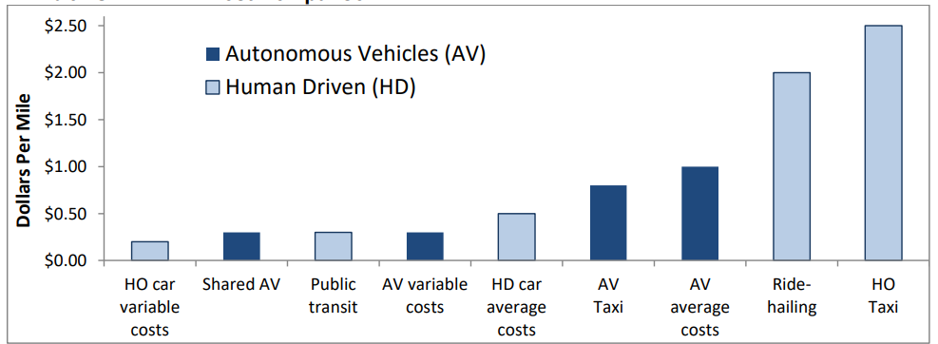
Cost Comparison
Autonomous vehicles (AVs) are likely to cost more than human-operated (HO) private vehicles and public transit, but less than human-driven taxis and ridehailing services.
Source: https://www.bilbloggen.dk/wp-content/uploads/2023/04/Autonomous-Vehicle-Implementation-Predictions.pdf
Notes:
Autonomous vehicles (AVs) are likely to cost more than human-operated (HO) private vehicles and public transit, but less than human-driven taxis and ridehailing services. Source: https://www.bilbloggen.dk/wp-content/uploads/2023/04/Autonomous-Vehicle-Implementation-Predictions.pdf

Slide 56
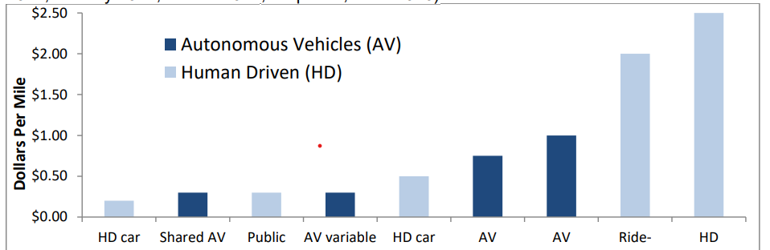
Total Cost Comparison
Autonomous vehicles (AVs) are likely to cost more than human-driven private vehicles (HVs) and public transit, but less than human-driven taxis and ridehailing services.
(Sources: AAA 2017; Bösch, et al. 2017; Johnson and Walker 2017; Keeney 2017; Litman 2021; Stephens, et al. 2016)
Notes:
Autonomous vehicles (AVs) are likely to cost more than human-driven private vehicles (HVs) and public transit, but less than human-driven taxis and ridehailing services.

Slide 57
Autonomous Vehicle Equipment and Service Requirements
All Autonomous Vehicles
Sensors (optical, infrared, radar, laser, etc.).
Automated controls (steering, braking, signals, etc.)
Software, servers and power supplies.
Data networks to access special maps, software upgrades, plus vehicle-to-vehicle connections.
Software and navigation map update subscriptions.
Critical component maintenance, repair and testing
Shared Autonomous Vehicles
Dispatching and fleet management.
Business administration and insurance.
Business profits.
Security.
Frequent cleaning and repairs.
Delays and empty vehicle-miles for passenger loading.
Autonomous vehicles, particularly those that are shared, will incur additional costs.
Source: https://www.bilbloggen.dk/wp-content/uploads/2023/04/Autonomous-Vehicle-Implementation-Predictions.pdf
Notes:
Autonomous vehicles, particularly those that are shared, will incur additional costs. Source: https://www.bilbloggen.dk/wp-content/uploads/2023/04/Autonomous-Vehicle-Implementation-Predictions.pdf

Slide 58
Interim Summary
Transition is coming very quickly!
  Most reports are extremely conservative
  Apply generally, but faster in many regions.
Very important to start incorporating AVs into planning now.
  To realize the benefits of AVS.
  Sacrifice expansion for maintenance.

Slide 59
What Changes Will This Bring?
Disposable income
Government finances
Transportation demand
Infrastructure
Housing
Public transportation
Employment
Parking
Potentially dramatic improvements in infrastructure planning and maintenance - Data sharing and integration

Slide 60


Disposable Income
Costs $12,182 to own a car.
Will cost $3,000 to use TaaS.
Net increase in disposable income
of > $9,000.
Spread across all households:
more than $1.3 trillion in new spending in the economy.
Major boost to economic activity.
  CREATING JOBS!
Notes:
https://newsroom.aaa.com/wp-content/uploads/2022/08/2022-YourDrivingCosts-FactSheet-7-1.pdf

Slide 61

Government Finances
Government finances thrown for a loop:
  Revenues up and down:
    Parking revenue, tickets, traffic violation revenues
    More commercial, retail and residential space
  Less spending on road development
  More (maybe less) spent on road maintenance
    Fewer road miles
    but perhaps more VMT

Slide 62


Transportation Demand
Demand for transportation will likely increase significantly:
price falls, demand rises
  Commutes may increase in distance, but
  not necessarily in duration.
  Zero passenger trips will arise.
    Deliveries
At the same time, demand for roadway lane-miles will likely decrease
  AVs make significantly more efficient use of space.
  Front to back and side to side.

Slide 63
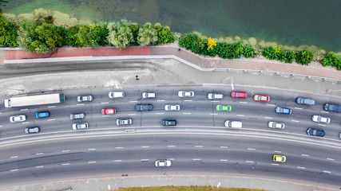
Infrastructure
Focus of transportation infrastructure:
  Currently on expansion
  Will turn toward:
    Maintenance
      Signage and striping has to be robust
      TaaS providers push for fewer potholes?
    Adding technology
      Stop lights will be digital as well as visual
  Some will disappear: Signs!

Slide 64
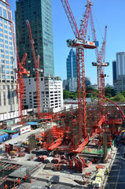

Housing
Housing is suddenly easier to build
  Issue of traffic congestion is significantly reduced.
  Space for new housing is available where parking lots used to be.
Existing houses can now accommodate more people:
garage to bedroom conversions.

Slide 65
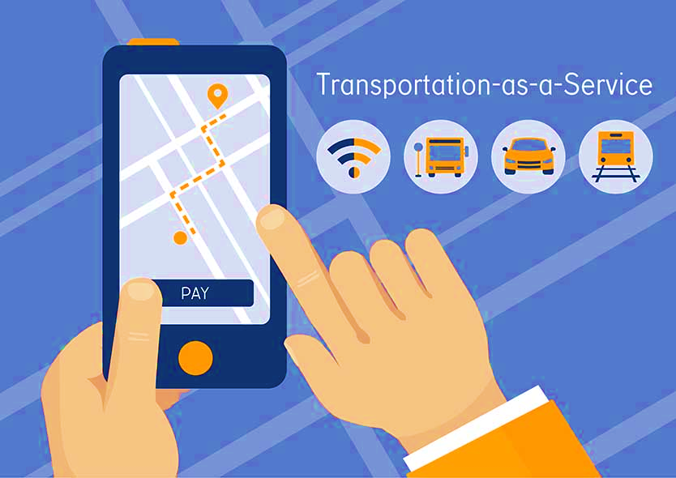
Public Transportation
Ambiguous implications for public transportation
Demand may:
  Shrink because of low cost of TaaS
  Grow because last mile problem is solved
Extensions may be added through contract with TaaS company

Slide 66
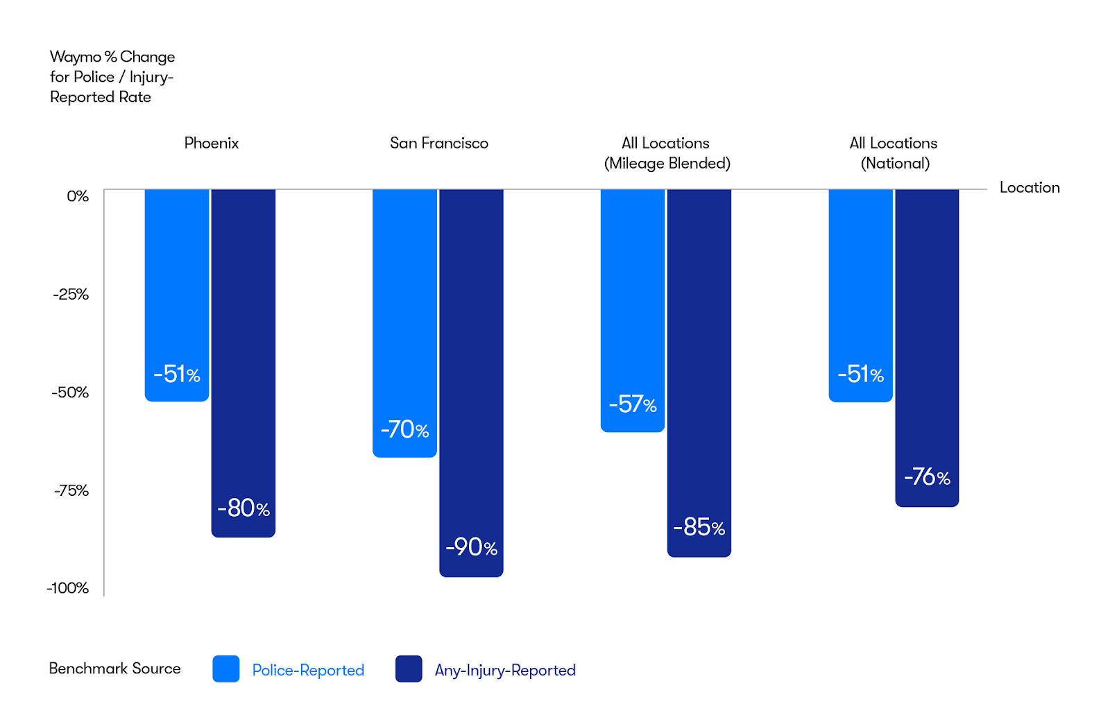
Who will pay the speeding ticket while using AV
Percent reduction for the Waymo Driver in police-reported and any-injury-reported crashed vehicle rates compared to human benchmarks
Source: https://waymo.com/blog/2023/12/waymo-significantly-outperforms-comparable-human-benchmarks-over-7-million/

Slide 67
Cautionary Tale From Long Ago
Automobiles impact on rail:
“The increasing dominance of cars was also felt by railway companies, which by June 1894 had to start making pricing concessions for transporting goods, even including free transport.”
- Samuel I. Schwartz, No One at the Wheel, 2018

Slide 68

Employment
Massive job displacement/relocation (Millions!):
  Drivers of all varieties: truck, taxi, delivery…
  Car production jobs, car parts production jobs
  Gas station, vehicle repair, and body shop
  Police and fire
  Health care workers
  And so on…

Slide 69

Employment (con’t)
What jobs will be created?
  IT jobs
  Retail/Production jobs
  ??
Always easier to identify things that will go away than to identify what will pop up in its place.
Regardless of where they are created, training programs will be crucial to the transition.

Slide 70
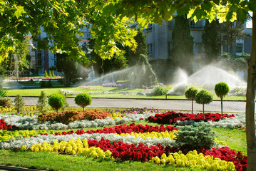
Parking
Greatly reduced demand for parking lots.
Service providers will own parking lots in strategic places.
  Where the cost of land is low.
Street parking will largely be a thing of the past.
  More green space in cities.
Shopping mall parking will be converted to:
  More shopping mall? Housing?
Apartment complexes will convert parking.

Slide 71
Freeing Up Urban Space from Parking
Los Angeles: 14% of incorporated land area
  200 Square miles
San Francisco: 275,450 on-street parking spaces
  Enough to parallel-park a line of cars 900 miles.
    California’s entire coastline is 840-miles.
  Enough parking to cover the Presidio, Golden Gate Park, and Lake Merced.
Nationwide: (estimate) 500 million spaces
  That’s larger than Delaware and Rhode Island combined.
  Could be as many as 2 billion (add in Connecticut and Vermont).

Slide 72
Potential Problems and Concerns
Expansion of the electric grid to provide sufficient capacity.
Mining for rare earth minerals for batteries.
Hacking of autonomous vehicles for nefarious purposes.
Competition in service provision in some markets.
And many more…

Slide 73
Summary of Change
Massive employment upheaval.
Local government finances will look very different.
Housing will be easier to build and more plentiful.
Parking conversions will be commonplace.
Demand for transportation infrastructure will likely decline.
  Transportation infrastructure technology will be a booming business.
Demand for public transportation may well decline.
Coming likely sooner rather than later!

Slide 74
Thank you!
Any Questions?
www.NEEDEcon.org
Arkadiusz Mironko, Ph.D.
amironko@iu.edu
Contact NEED: info@NEEDEcon.org
Submit a testimonial: www.NEEDEcon.org/testimonials.php
Become a Friend of NEED: www.NEEDEcon.org/friend.php

